Slide 1
Lab Exercise 2
Solar Pond Data Frame

Slide 2
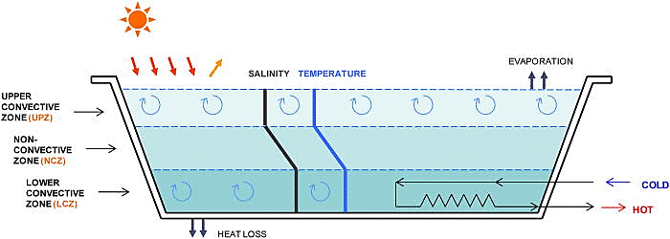

Slide 3
Experimental Setup
Hood
T1, T2, T3
Halogen Lamps
T4, T5, T6
Digital Temp Indicator
Thermocouples
Sampling vents
T∞
T0
T7
Water Inlet
Water Outlet

Slide 4
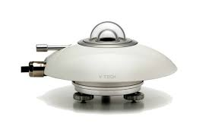
Experimental Setup
Solar Pond
Water Storage Tank
Heat Exchanger
Collecting tank

Slide 5

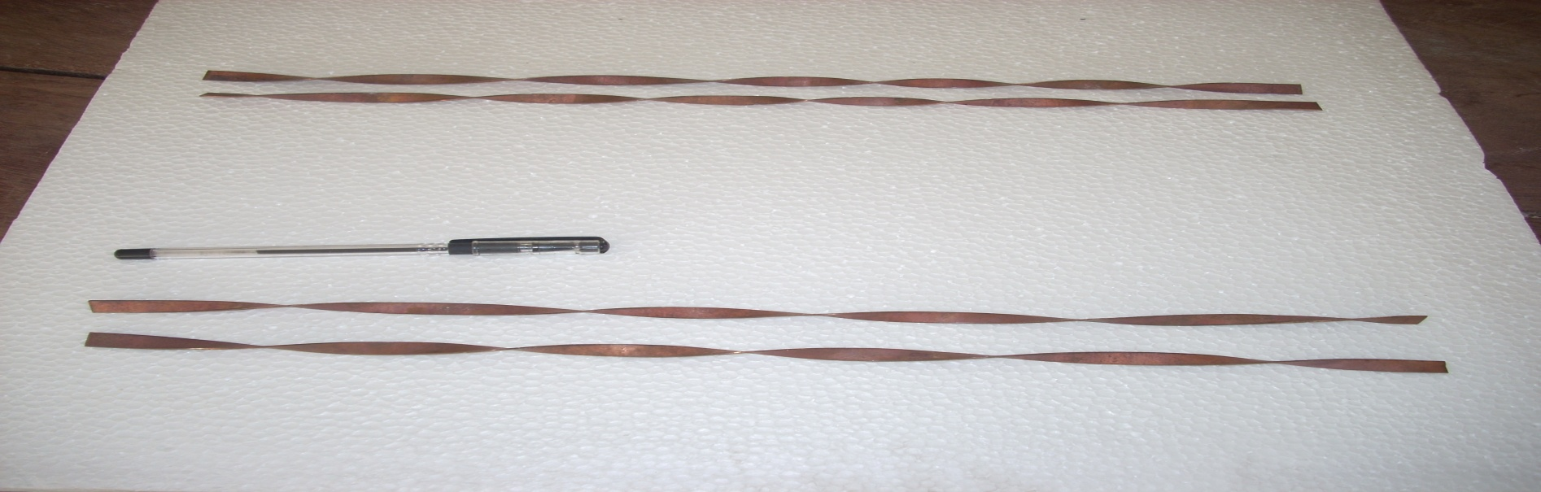
Experimental Analysis of Solar Ponds With Twisted Tape Inserts
D
L
Twist ratio Y = L / D
For Twist ratio Y =10.6 D = 8mm; 3L = 254.4mm; 3L’ = 300mm
For Twist ratio Y =6.36 D = 8mm; 5L = 254.4mm; 5L’ = 300mm
TWISTED TAPE DIMENSIONS

Slide 6
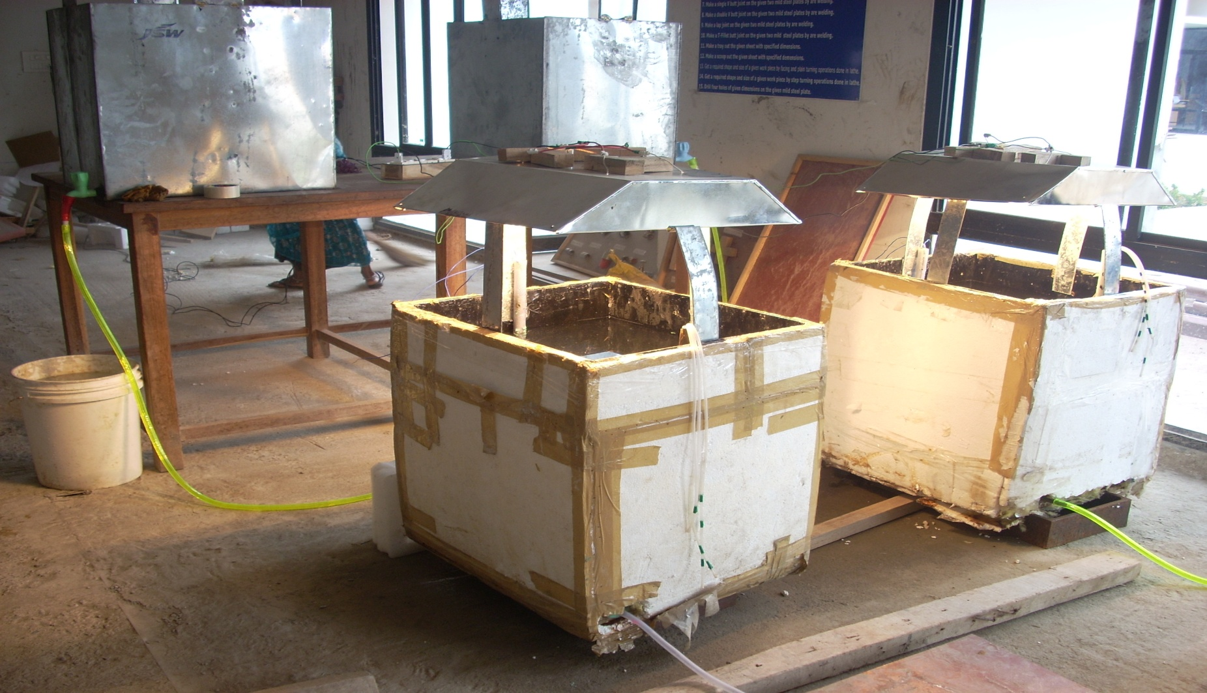
Experimental Setup

Slide 7
Solar Pond
Input :
Time
Pyranometer Reading (Solar Irradiation)
Inlet water temperature
Ambient temperature
Flow rate
Output:
(i) Two (Outlet Water Temperature)
(ii) Qact (Energy Extracted)
(iii) Efficiency of Solar Pond
(iv) Effectiveness of HX
Conditions:
No twisted tape (Plain tube HX)
Three twists in twisted tape
Five twists in twisted tape

Slide 8
Lab Exercise 2
Consider 25 observations from the given dataframe titled ‘data’, store first 5 observations (6:00-08:00 ) in ‘data1’, next 10 observations(8:30-13:00) in ‘data2’ and the last 11 observations (13:00-18:00) in ‘data3’. Perform the following using R Programming,
rbind (data1, dat2)
Store Temperature column : LCZ(TT=0), LCZ(TT=3), LCZ(TT=5), in variables V1, V2 and V3 respectively. Cbind all these three columns.
Plot Time Vs Pyranometer reading of ‘data’ for the month May
Plot Pyranometer reading Vs Two
Plot Pyranometer reading Vs Qact
Pyranometer reading Vs degree of temperature rise (ΔT1)
Determine the best linear fit equation between Pyranometer reading and Two/Qact/Efficiency/Effectiveness
Plot the best linear fit
Determine the Residual Sum of Squares (RSS)
Plot the residuals.

